Slide 1
Quantum Computing for KEA Digital – Computer science Double split experiment
Tom Stevns
Notes:
60

Slide 2

Prerequisites
Do like abstractions
Physical impact
Phytagoras
A little bit about probabilities
^{Curiousity}
Notes:
60
Mohrs Law
The Margolus–Levitin theorem sets a bound on the maximum computational speed per unit of energy: 6 × 10³³ operations per second per joule. This bound, however, can be avoided if there is access to quantum memory. Computational algorithms can then be designed that require arbitrarily small amount of energy/time per one elementary computation step.^{[3][4]}
But about 6 × 10³³⁰ is it possible or even higher

Slide 3

Purpose of this lecture
Students will learn about the double-slit experiment
In order to learn understand the concept of wave - particle duality, the cornerstone principle of quantum mechanics.
The demonstration of the experiment is based on advanced visualization techniques.
Notes:
60

Slide 4

We touch topics like:
Physical experiment
Light as Particles
Light as Waves
Interference
Coherence
Lasers
Duality
Newton, Young & Einstein
Notes:
60

Slide 5
Introduction
Description:
Students will perform the double-slit experiment in order to learn about the concept of wave - particle duality, the cornerstone principle of quantum mechanics. The demonstration of the experiment is based on advanced visualization techniques.
Age Range: 15-25 Learning Time: more than two hours
Educational Objectives:
to understand: Students have the opportunity to learn about the wave-particle duality and understand the nature of elementary particles by carrying out the famous double slit experiment.
conceptual knowledge: Students learn about the nature of light and electrons and understand how different phenomena that we observe are produced.
to recognize values: Students get to explain phenomena that occur in everyday life by learning about the nature of light.

Slide 6
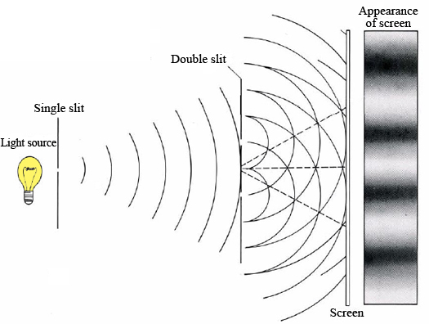
Overview
Guidance for Preparation
The double-slit experiment is a classic physics experiment first performed in the early 1800s by the English scientist Thomas Young in an attempt to resolve whether light is a particle or a wave. Using sunlight diffracted through a small slit, Young projected the light rays emanating from the slit onto another screen containing two slits placed side by side. Light passing through the pair of slits was then allowed to fall onto another screen.
Young observed that when the slits were large, spaced far apart and close to the next screen, then two separate patches of light formed on the screen. However, when he reduced the size of the slits and brought them closer together, the light passing through the slits and onto the screen produced distinct bands of color separated by dark regions in a serial order, known as interference patterns. These patterns could only be produced if light were acting like a wave.

Slide 7
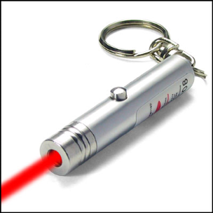
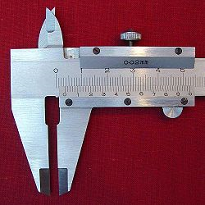
Overview
Then in 1905, Albert Einstein showed that light is a collection of discrete particles, which that he called "photons." When the double-slit experiment is repeated using single photons, an interference pattern is also seen, despite the notion that a single particle shot toward the screen should not be able to interfere with itself. The fact that light sometimes behaves as a wave and sometimes behaves as a particle is known as the wave-particle duality. Subatomic particles like electrons exhibit a similar wave-particle duality. The attempt to discover why this occurs has generated numerous theories, from Niels Bohr's Copenhagen interpretation to Hugh Everett's Many-Worlds interpretation.
Experimental Set-Up The demonstration/experimentation includes two main experimental set-ups. The first includes the experimental set-up for the demonstration of the light interference. This could be easily demonstrated with the use of a laser pointer. The second experimental set-up is based on the use of the Double Slit miniature exhibit that has been developed in the framework of the Science Center to Go project. You will need: - Laser Pointer and a Vernier - Science Center to Go AR Software - Science Centre to Go Double Slit Miniature Exhibit - PC and projector & Internet access

Slide 8
Inquiry-based Teaching Model
Phase 1: Question Eliciting Activities
Exhibit curiosity
Define questions from current knowledge
Phase 2: Active investigation
Plan & conduct simple investigation
Propose preliminary explanations or hypotheses
Phase 3: Observation / Experiment
Gather evidence from observation
Phase 4: Discussion
Consider other explanations
Phase 5: Reflection
Communicate explanation

Slide 9

Question Eliciting Activities
Provoke Curiocity
Have a look to this great presentation by Michio Kaku (Parallel Worlds) on the Nature of Light (time slot 1.30-5.20). This video could be presented to the students as an introduction to the double nature of light.
You can repeat the Michio Kaku demonstration by using the laser pointer (fixed in a specific place) and the vernier to create the small slit that the light goes through. Following the Michio Kaku you can demonstrate to your students the "disappearance" of light after the slit.
You can also present them the case of sea waves interference which is described in the video. Here is a photo of the sea wave interference from the "Boidokilia Beach" at the SW end of Peloponnesus, Greece (This is claimed to be the port of Pylos, the kingdom of wise King Nestor).

Slide 10
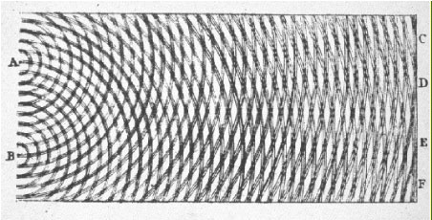
Question Eliciting Activities
Define questions from current knowledge
Following the demonstration (dissapearance of light) you can introduce a series of questions to your students:
- What kind of waves do you know of? The main focus should be on electromagnetic waves and their properties.
- What happens when waves interfere? The ideas of constructive and destructive
interference are discussed along
with the interference pattern produced.
- Why do we refer to light as
electromagnetic waves and as
photons at the same time?
Is it a wave and a particle at
the same time?
-What is light?
From T. Young, “Course of Lectures on Natural
Philosophy and the Mechanical Arts,” 1807.

Slide 11
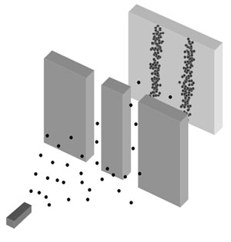
Question Eliciting Activities
Define questions from current knowledge
At this point we can introduce to the students the following experiments
(we can show to them the experimental device):
a) In one experiment light is travelling from a source to a photographic plate, through a double slit.
b) In a second experiment electrons are travelling from a source to a detecting screen, through a double slit.
c) In a third experiment marbles are travelling from the
source to an array of collecting bins, through two slit-like
openings, side by side.
The figure on the right shows the experimental set-up.
You can ask the student to make graphs show roughly
the possible patterns which could be detected on the
various screens.

Slide 12
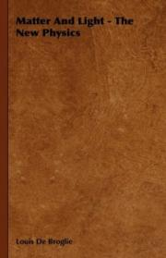
Active Investigation
Propose preliminary explanations or hypotheses
The teacher asks the students to present their ideas and to make some initial hypothesis about the nature of the electrons: should they behave like light or like the marbles? (This part of the exercise is of great importance as it is the cornerstone of the inquiry process and extra attention should be paid. It is vital to have students make predictions and after performing the experiment come back to them and revaluate their initial prediction so as to realize where and why they were wrong).
Common Students' Misconceptions: The most common misconceptions are: 1. Electrons must be a particle (they must behave like the marbles), not a wave. 2. Electrons cannot dissapear. The position of a particle can always be known at a specific time.
After students have made their predictions the teacher presents the de Broglie hypothesis. Luis de Broglie received the Nobel Prize in Physics for his Hypothesis. Here is the Award Ceremony Speech (December 10, 1929).

Slide 13
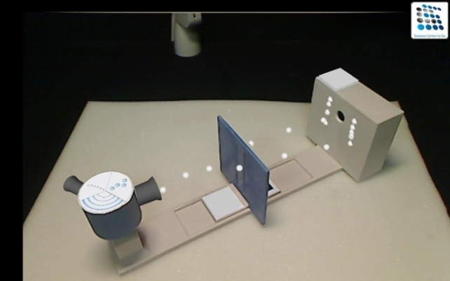
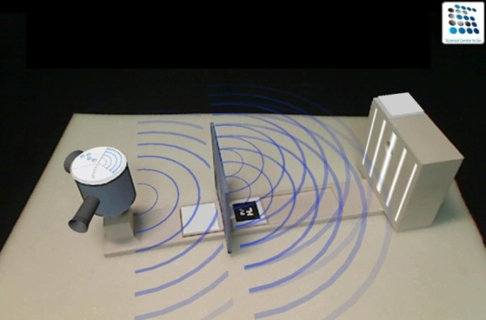
Active Investigation
Plan and conduct simple investigation
Augemented Reality is presented to the students. It is noted to them that this technology is used to visualize (through augmentations) the invisible. For example we are not able to see the electrons as we have done in the experiment with the laser.
The system allows to demonstrate all the phases of the proposed experiment. The teacher should prepare so he can start at a later stage to present to the students ***** (a) the classical particle case,
(b) the wave case and
(c) the quantum case where interference pattern is presented to the screen behind the frame with the slits.
?
* Resources for
Teachers only

Slide 14
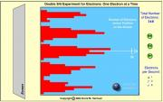


Observation / Experiment
Gather evidence from observation
The teacher is using the Double Slit Mianiature exhibit, following the guidelines that are provided with the Tool-Box.
First the system is set at the "wave" mode and the interference of simulated waves (light) is observed.
Then the system is set at the "particle" mode and the case of marbles (classical particle) is studied.
Then the case of electrons (quantum particle) is studied.
At each stage of the experiment students write down their observations and outcomes (a detailed worksheet is provided).

Slide 15
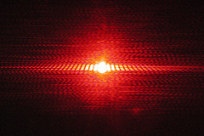
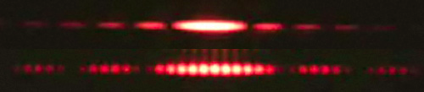
Observation / Experiment
Gather evidence from observation
The Interference of light is shown through a simple experiment with a laser pointer and single / double slits.
Laser beam through a single slit (use Vernier)
Laser beam through a double slit

Slide 16
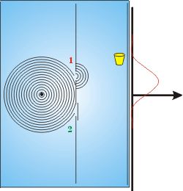
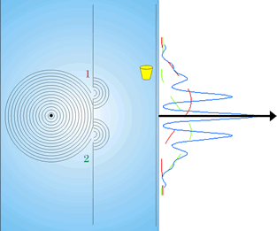
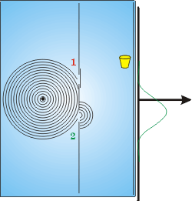
Observation / Experiment

Slide 17
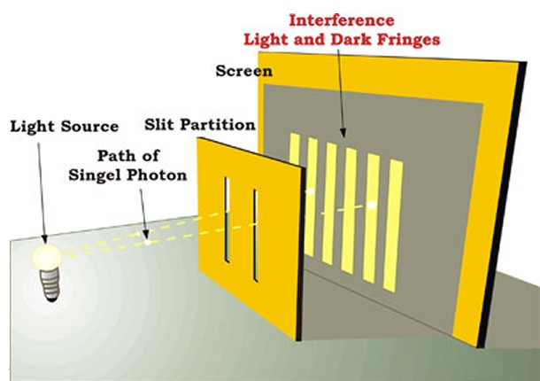
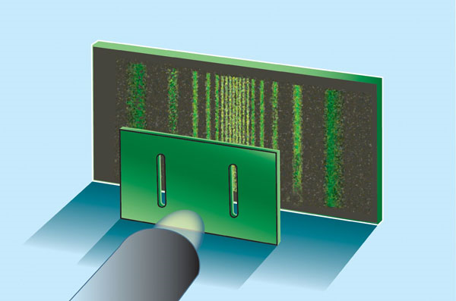
Observation / Experiment
Explanation based on evidence
Based on the observations teacher explains that electrons present a wave-like behavior when they are going through the double-slit frame. Their behavior is exactly the same with the behavior of the waves that interfere and the behavior of the photons. This link provides a simplified explanation of the Double Slit Experiment (Dr. Quantum). At this point it is recommended to present to the students this game-like animation that summarizes the whole process. It is very important to keep their interest high as in the following activities quite complex phenomena are going to be discussed and analyzed.

Slide 18
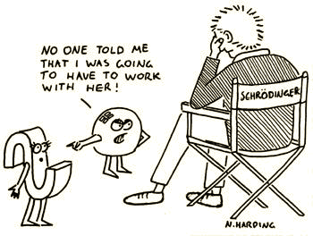
Discussion
Consider Other Explanations
To get an interference pattern we take a wave, split it up into two parts, send each part through one of the slits, and then recombine the waves. Does this mean that a single electron is somehow going through both slits at once? Another explanation that could be possibly given about the origins of the interference pattern is that the electrons going through the left slit are somehow interacting with the electrons going through the right slit. Note that we have no idea what such a mechanism could be, but are a little desperate to understand what is going on here.
We can explore this idea by slowing down the rate of electrons from the gun so that only one electron at a time is in the system. What we do is fire an electron, see where the flash of light occurs on the phosphor screen, wait a while for everything to settle down, then fire another electron, noting where it lands on the screen. After we have fired a large number of electrons, we will discover that the distribution of electrons is still the interference pattern.

Slide 19
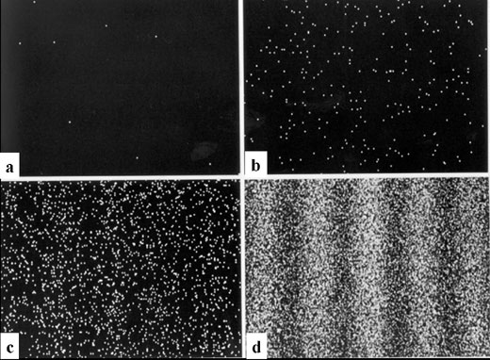
Discussion
Consider Other Explanations (continued)
The conclusion of all this is that there is no experiment that can tell us what the electrons are doing at the slits that does not also destroy the interference pattern. This seems to imply that there is no answer to the question of what is going on at the slits when we see the interference pattern. The path of the electron from the electron gun to the screen is not knowable when we see the interference pattern. As Heisenberg said, "The path [of the electron] comes into existence only when we observe it."
The Electron Interference Experiment performed by Akira Tonomura and co-workers at Hitachi in 1989 demonstrates experimentally that in fact electrons should interfere with themselves.

Slide 20
Reflection
Communicate Explanation
The students should report on the realized activities. The will need to prepare a report that includes the rational of the experiment, the initial design of the experimentation, the experimental set-up, the realization of the process, the analysis of the findings and a discussion on the results. Students could work in groups, prepare their reports and then present them in the classroom.
Follow-up Activities
For the assessment of the proposed activities a conceptual understanding test and a semi-structured interview template are proposed to be used as data collection tools. This interview includes two main questions that will teacher to investigate the consistency of students' perspectives across contexts by comparing students responses to the essay question on the double slit experiment (A) with a statement regarding the position of an electron in an atom (B). The interview has to take place following the realization of the experiment. It is important to make notes and to try and get detailed explanations of the students selections.
This should be done by a Kahoot test , saved as anonymous

Slide 21
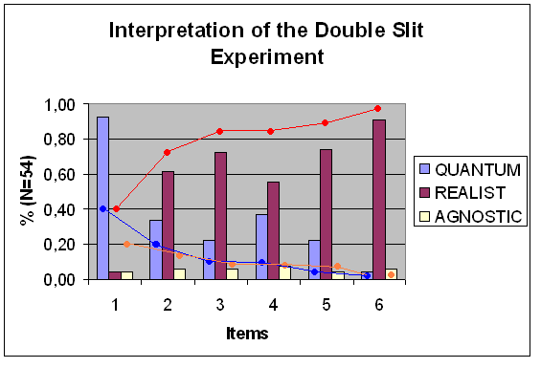
Assessing the impact of the SCeTGo on the understanding of quantum interpretation
of the Double Slit Experiment
54 students 24 interviews
The results from the application of the six items questionnaire are presented in comparison with the average values of the QPCS. At the first four questions the impact of the SCeTGo system is obvious.
Almost all students who have answer the questionnaire following a quantum perspective disagree with the statement that the electron has a defined position in an atom.
Data analysis performed by Dr. Sofoklis Sotiriou

Slide 22
Thank you !!!
To see the full scenario please go to:
Copenhagen School of Design and Technology Fronter room
Elective Introduction to Quantum Computing
For more info on this topic please feel free to contact me:
Tom Stevns
toms@kea.dk
www.kea.dk

